Slide 1
Immersive Rigging and Skinning in Virtual Reality Environments
supervised by David Groß
Notes:
It's my great honor to speak to you today.
I have worked for this project for about 6 months and pleased to show you here.

Slide 2
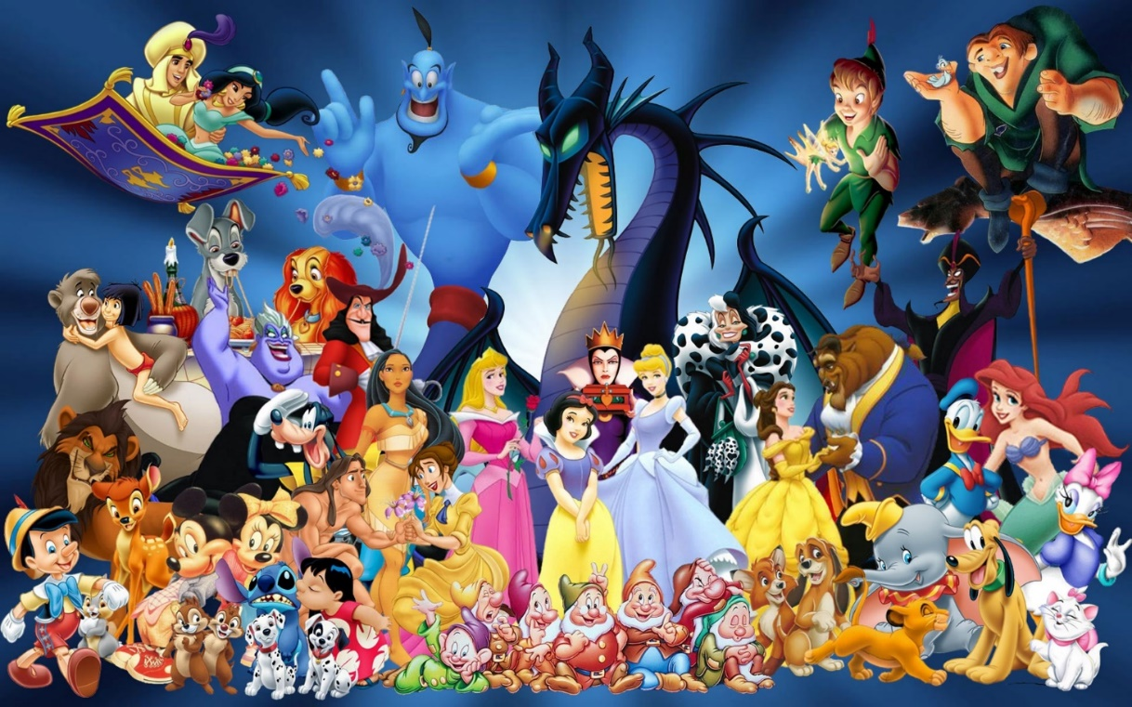
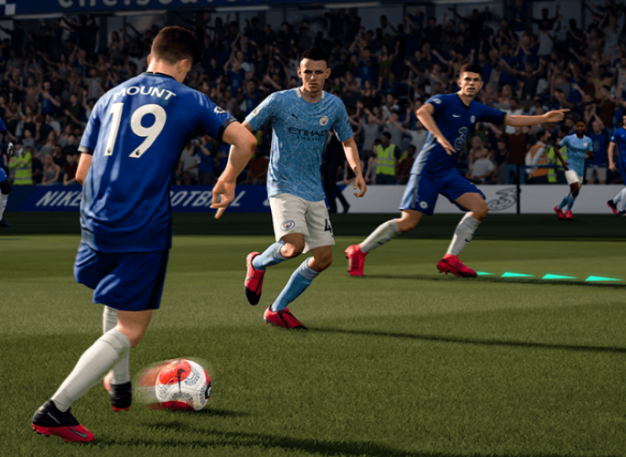
background
This project is about creating animation with the help of VR technology. Animation is one of the main goals of CG
Character animation brings Characters to life. It is prevalent in films, video games, television series and so on.

Slide 3
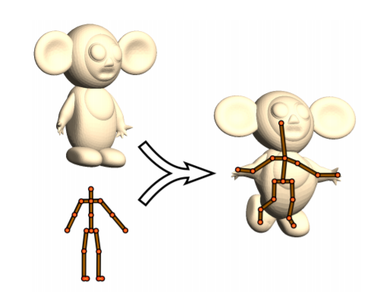
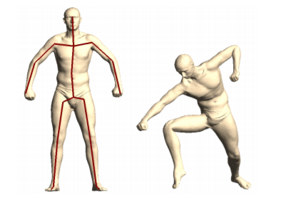
A brief introduction-immersive rigging and skinning
Character Animation needs Rigging and skinning
What is Rigging?
Define a skeleton for a given Mesh.
What is skinning?
Bind mesh to the skeleton.
Before skinning: mesh is not affacted by the skeleton.
After skinning: mesh follows the skeleton movements.
rigging
skinning
Notes:
My topic is immersive rigging and skinning, so what is rigging….
That’s to say, if the skeleton changes, the mesh will be changed at the same time…

Slide 4
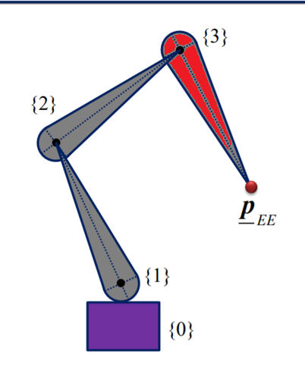
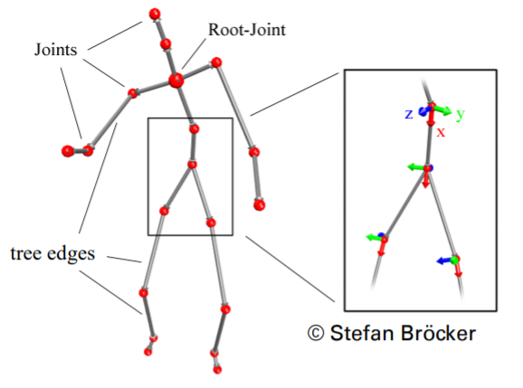
A brief introduction（Rigging）
How bones are defined?
What about a skeleton?
Bone root
Bone tip
Notes:
We define here as the root of a bone and here as it’s tip.
//
A skeleton can be built with bones, the bone roots are defined as joints.
We assume that the bones are stiff and hard, can’t be broken. And we only have orientations at joints.
//
At each joint, we have a local coordinate system, It helps to define dofs.
So, what is dofs?

Slide 5
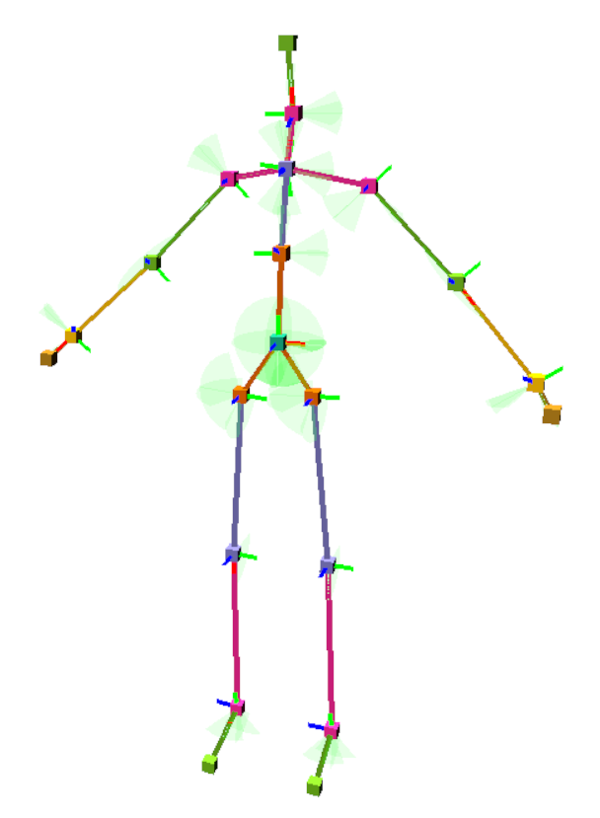
A brief introduction（Rigging）
What is degrees of freedom (DOF)?
the number of independent parameters defining the state.
Notes:
Eg. Let’s take a look at the elbow, we ausme that it has only one dof, can only rotate 0-135 degrees around the local y axis

Slide 6
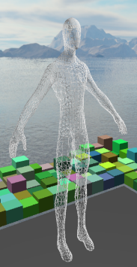
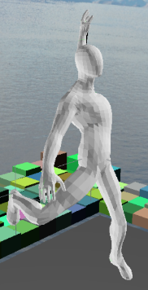
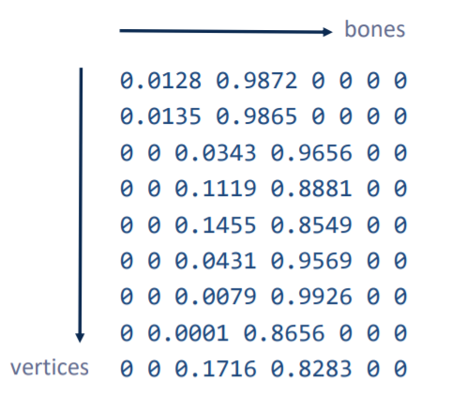
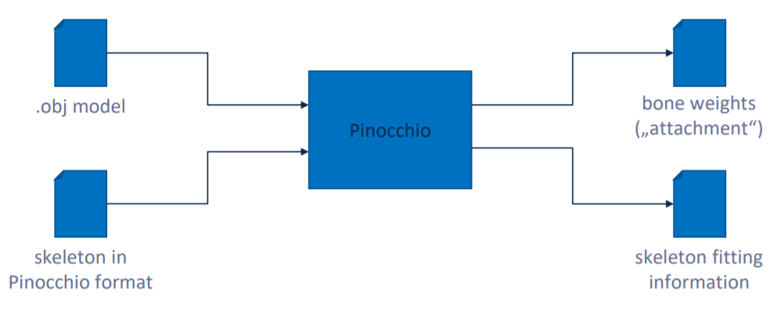
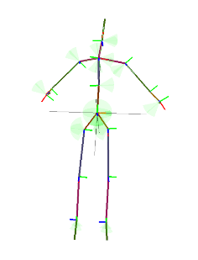
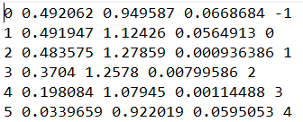
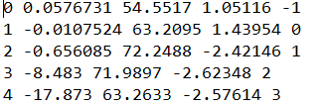
A brief introduction（skinning in detail）
Bone Id Bone position Parent ID
Notes:
This is what a skinning system looks like, eg. The Pinocchio lib. Takes an obj and a skel as input. Skel are stored with list of bones: bine id, bone position and its parent ids. Bone weights will be gen. after the skinning process and a modified skeleton.

Slide 7
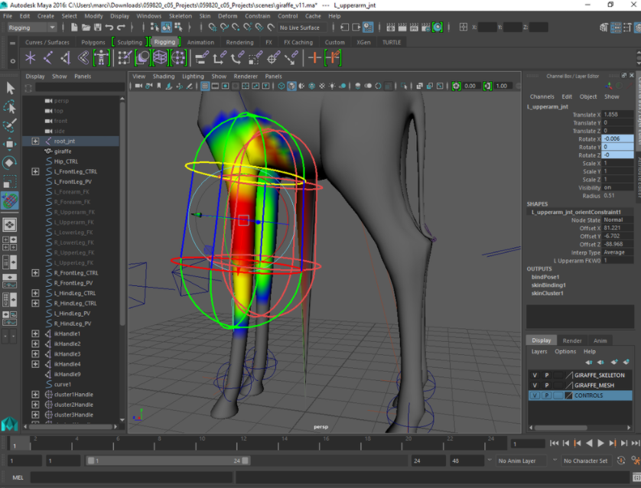
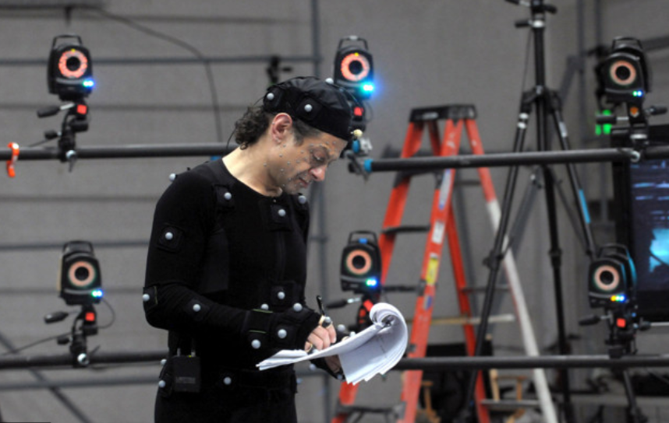
Motivation-Why Rigging and Skinning in immersive env
Rigging and skinning of 3d models usually involves sophisticated algorithms for fitting skeletons into meshes.
To gather realistic movement data, complicated motion capturing system may needed.
These are changed by VR!
Immersed in a VR environment, the user finds himself in a familiar coordinate space, working with 3d models is intuitive.
Interactively create and manipulate a skeleton with ease.
Traditional rigging/skinning process
Traditional Mocap System
Notes:
Here is the motivation, why we’d like to perfrom the rigging and the skinning in vr ?
Traditionally,…..
Expensive system

Slide 8
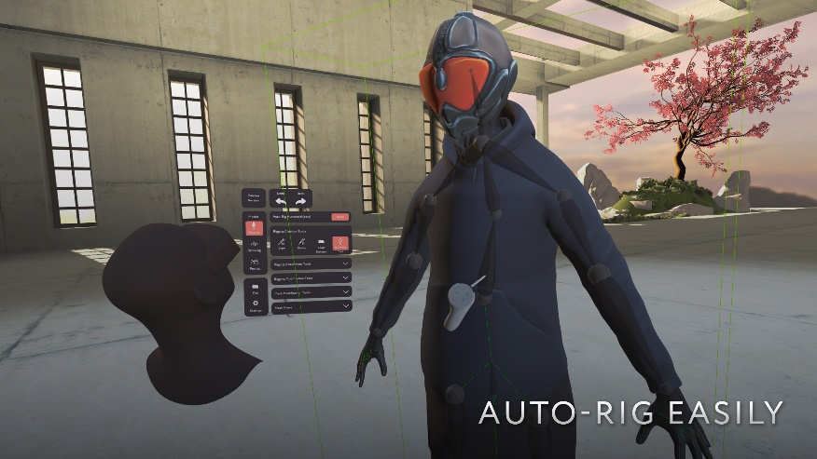
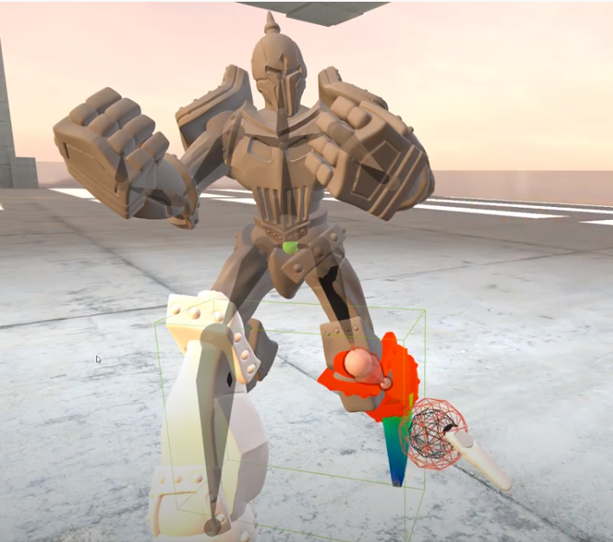
Related works (Immersive rigging)
MasterpieceVR [A. Cannavò et al. 2019]
Pros:
Mirroring bones
Intuitive skinning tool
Cons:
Switch between diff. Skeleton types. (BVH, )
Can not define Dofs for each bone.
Can not apply user‘s motion to the model.
https://www.youtube.com/watch?v=NcByctd_PNg

Slide 9
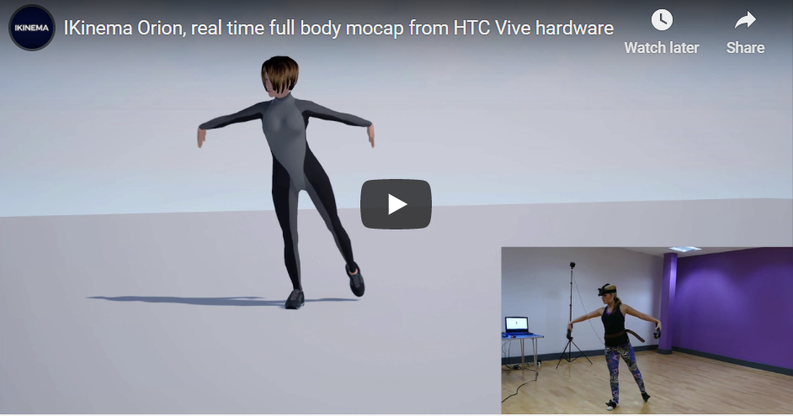
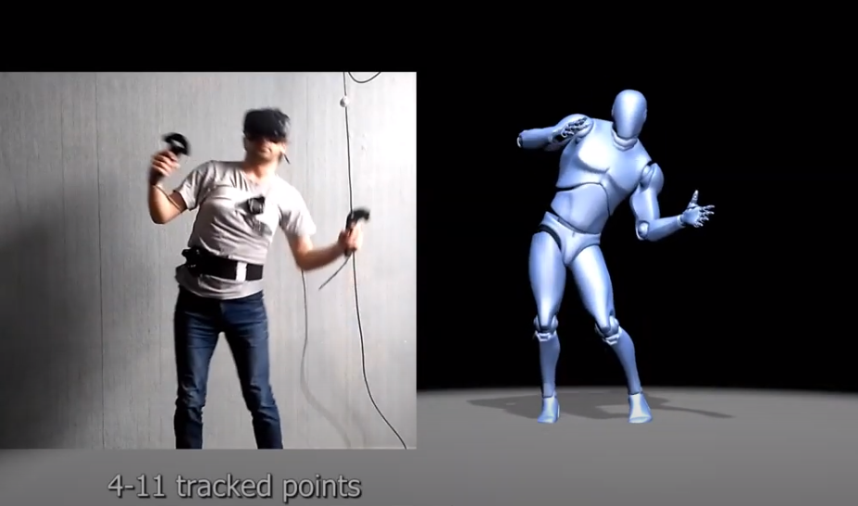
Related works (Immersive motion capturing with IK)
Ikinema [Jiang, Fan et al. 2016]
VR Mocap Studio [Daniel Kade et al. 2013]
Pros:
Low cost, user friendly (gamers).
No need for specific calibration (Ikinema, not the other).
Cons:
Dof adjestments not supported
Custom skeletons not supported
At least 4 trackers
https://www.youtube.com/watch?v=Khoer5DpQkE
https://www.youtube.com/watch?v=QUsJbcyeRUI

Slide 10
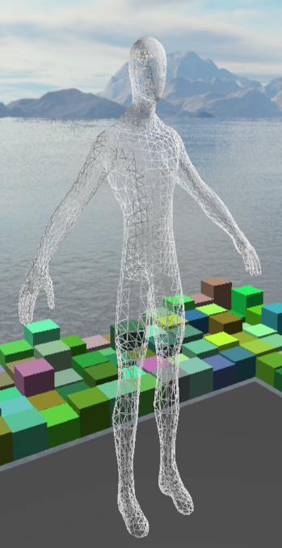
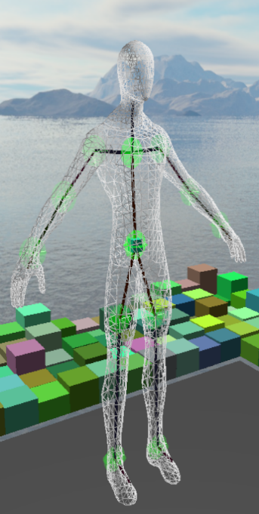

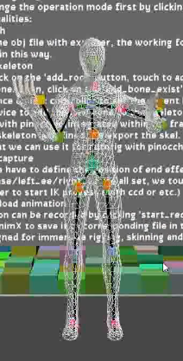
Main tasks/ System overview
Simple and extensible software for Rigging, Skinning, Animation and Motion Capturing
With the help of the CGV framework: https://github.com/sgumhold/cgv/tree/develop
Mocap/
Rigging
Animation
Skinning
Refine
System Overview
Notes:
deeper explaination of the workflow

Slide 11
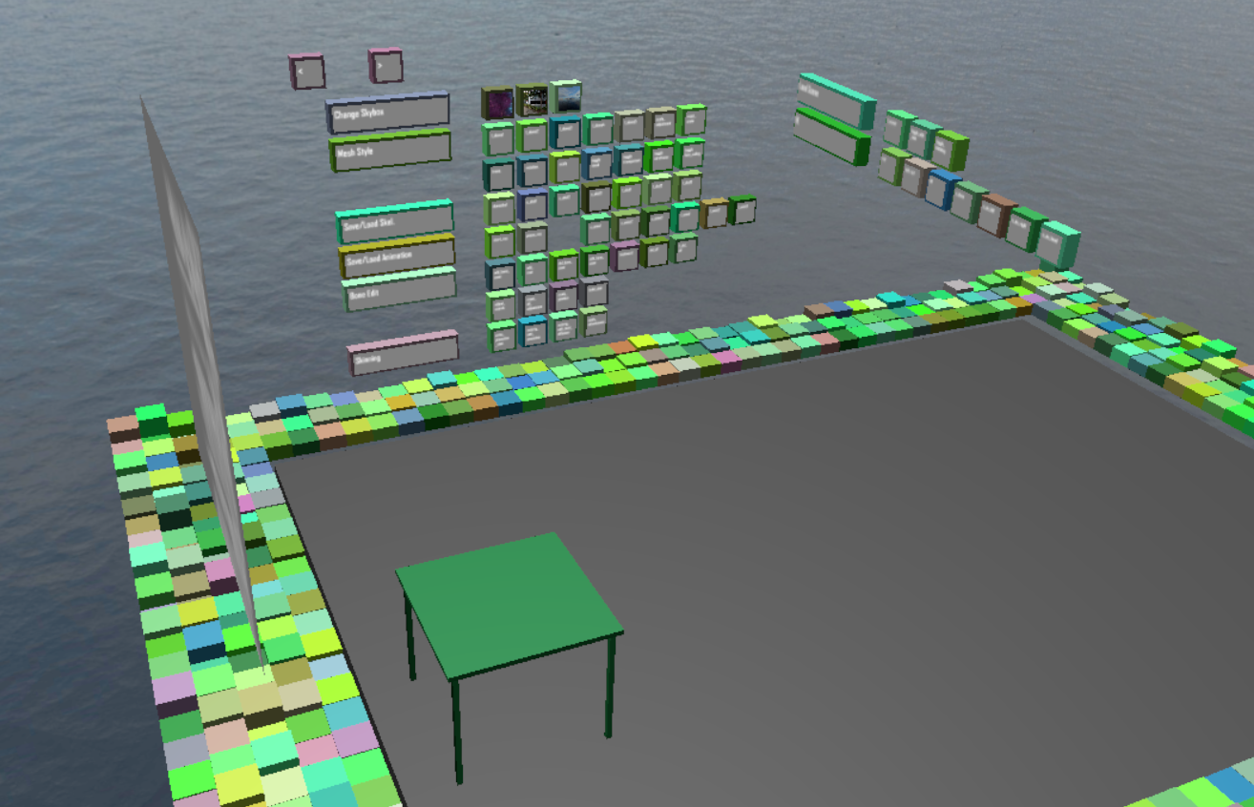
Basic user interface
Task 1: The „BoxGui“
flexible and extensible:
A simple solution for interaction. Different kinds of widgets are supported. Buttons can easily be managed into groups.
There is a “boxgui_button” class to manage the properties of the buttons. In a header file called “BoxGui.h”.
Visual feedback: a pushing effect
provided when intersection happens between the ray emitting from right hand controller and the button.
But
can only support a few words on each button, which makes it a little bit hard for users to know the functionalities.
Buttons are arranged on a virtual wall. They are assigned to random colors.

Slide 12
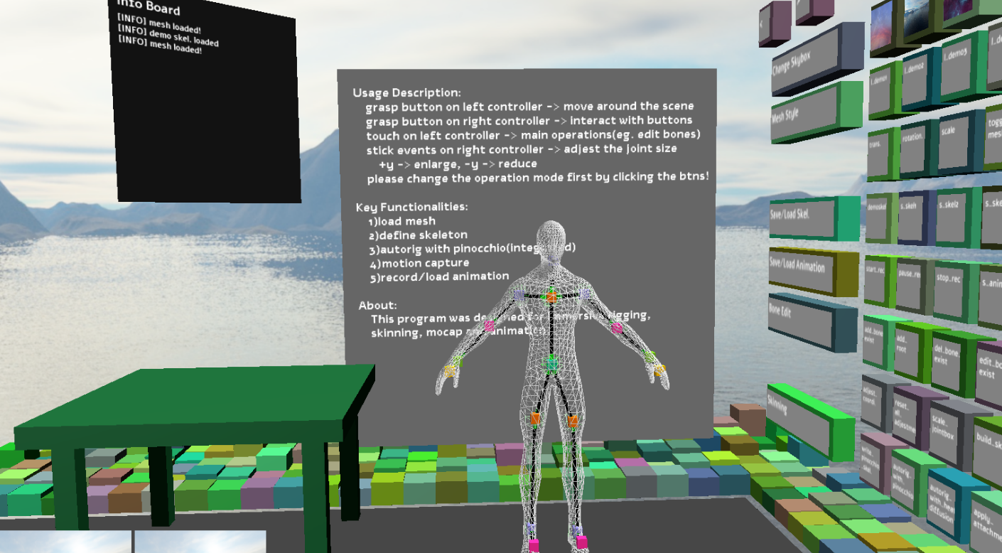
Create and manipulate bones for a given mesh
Task 2:
2.1: Render A Given Mesh
A custom mesh renderer:
It contains a vertex shader, a geometry shader, a fragment shader, and some c++ codes to upload/ update data. E.g. bone attachment matrices, model view matrix, and some Boolean variables. The mesh can thus be adjusted according to bone movement.
Different rendering modes possible:
One can render the given mesh in one of the following modes: transparent mode, wireframe mode and back face culling.
The view from the initial pose, and the mesh is rendered in wireframe mode.

Slide 13
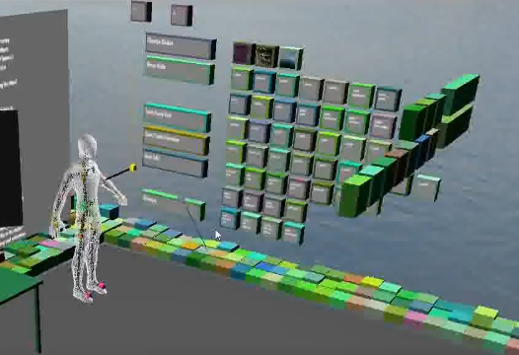
Create and manipulate bones for a given mesh
2.2: Modifications to An Existing Skeleton
Iterative workflow:
A load of a predefined skeleton from disk is supported. That means one can continually refine a skeleton in a simple way.
Flexible:
It is quite flexible that skeletons can be defined for a given mesh in any shape.
Currently supported operations:
One can add, delete and modify(position+orientation) the selected bone.

Slide 14
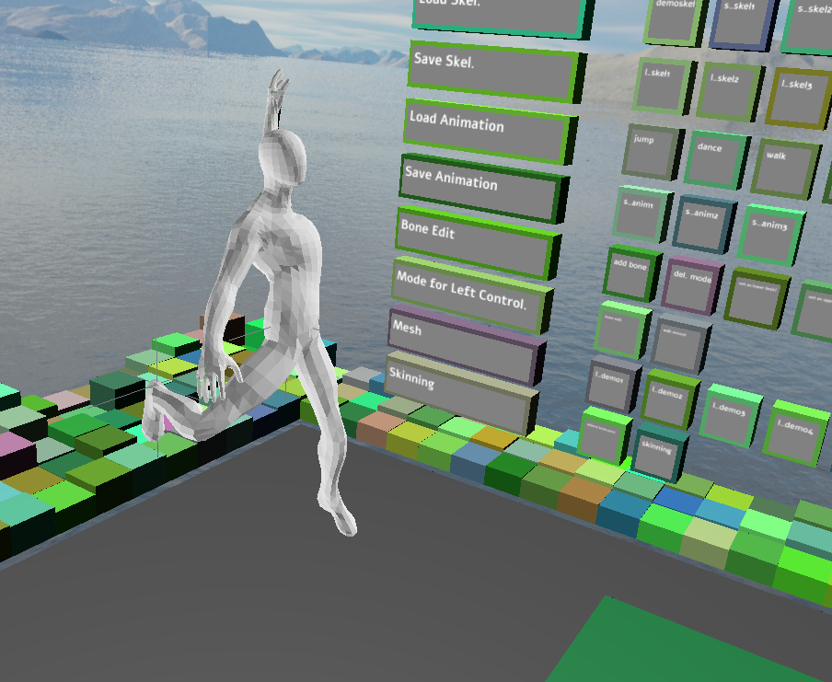
Skinning of a mesh with the created skeleton
Task 3: Skinning With Pinocchio Library
Generate a skeleton:
When rigging is finished, a skeleton is defined and transformed to a special format which can be feed into Pinocchio.
Apply auto-rig
Load attachments:
The attachment data for bones is available as output file. We have to load it explicitly in the VR scene, by clicking the “apply_attachments” button.
Alternative:
As the skeleton is defined according to the given mesh directly, we can assume that it will fit the mesh well. Thus a custom skinning tool may be a better choice. This belongs to future work.
The given mesh can be adjusted according to the skeleton. Which provides an animation effect. Here we take the spiderman as an example.

Slide 15
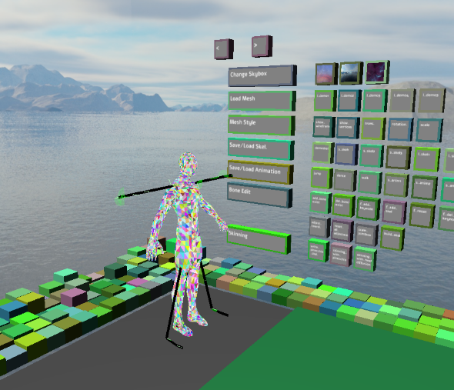
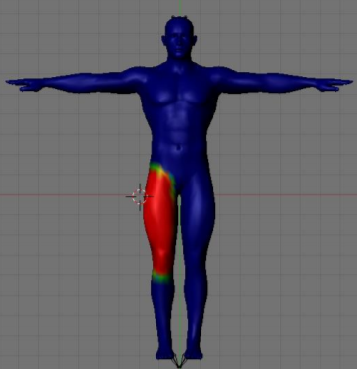
Visualize the skinned mesh
Task 4: Visualize The Skinned Mesh
Method1:
We can visualize a skinned mesh by varying the position/ direction of individual bones.
Method2:
Individual bones can be colorized , depending on the bone weights.
The skinned mesh can be visualized in more than those two ways.

Slide 16
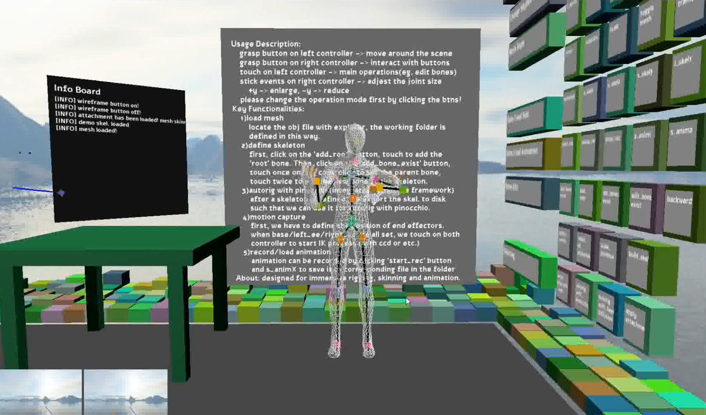
Record users movement with ik
Task 5: Record Users Movement with IK
capture the user movements in VR
we can define target positions with the help of controller positions as well as headset position. (Or other trackables) The other parts of the skeleton of the character can be adjusted accordingly with help of IK algorithm.
We may not get an accurate result,
But an acceptable result of the motion can be captured without special equipments.
Which is suitable for the case of VR games and some other similar applications.
A acceptable result can be acquired with minimal effort.

Slide 17
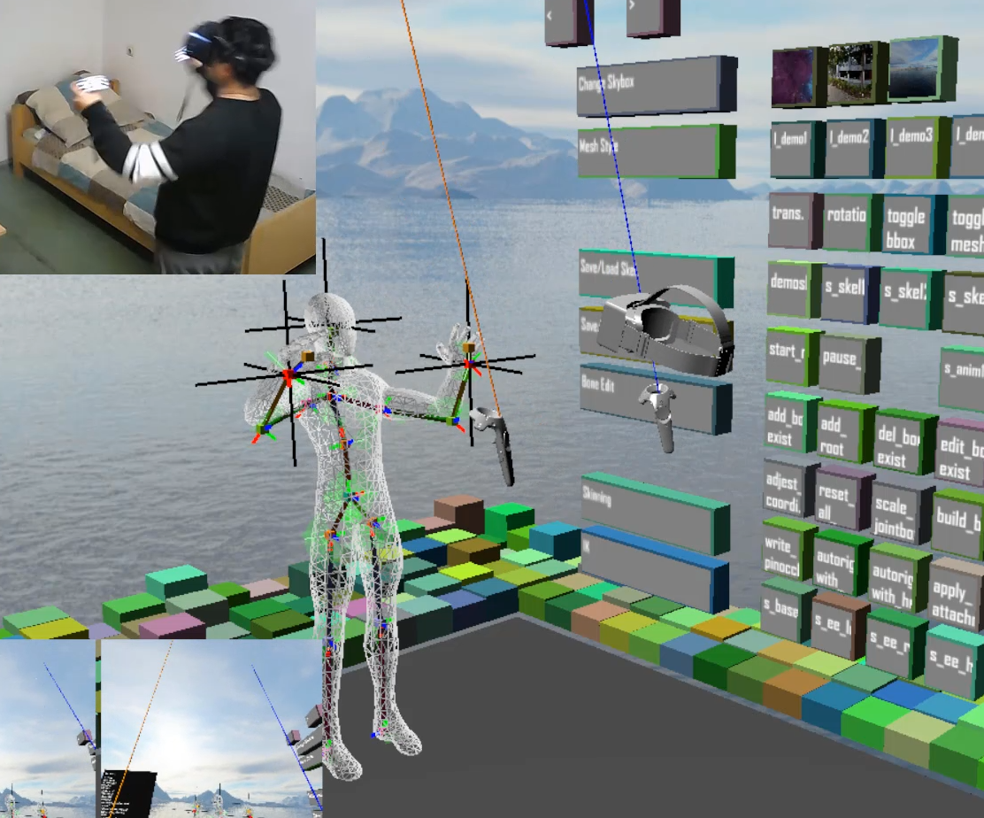
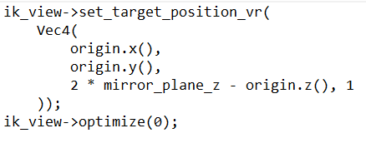
Record users movement with ik
How can we control the 3d avatar?
Compute target positions with the help of current user’s state.

Slide 18
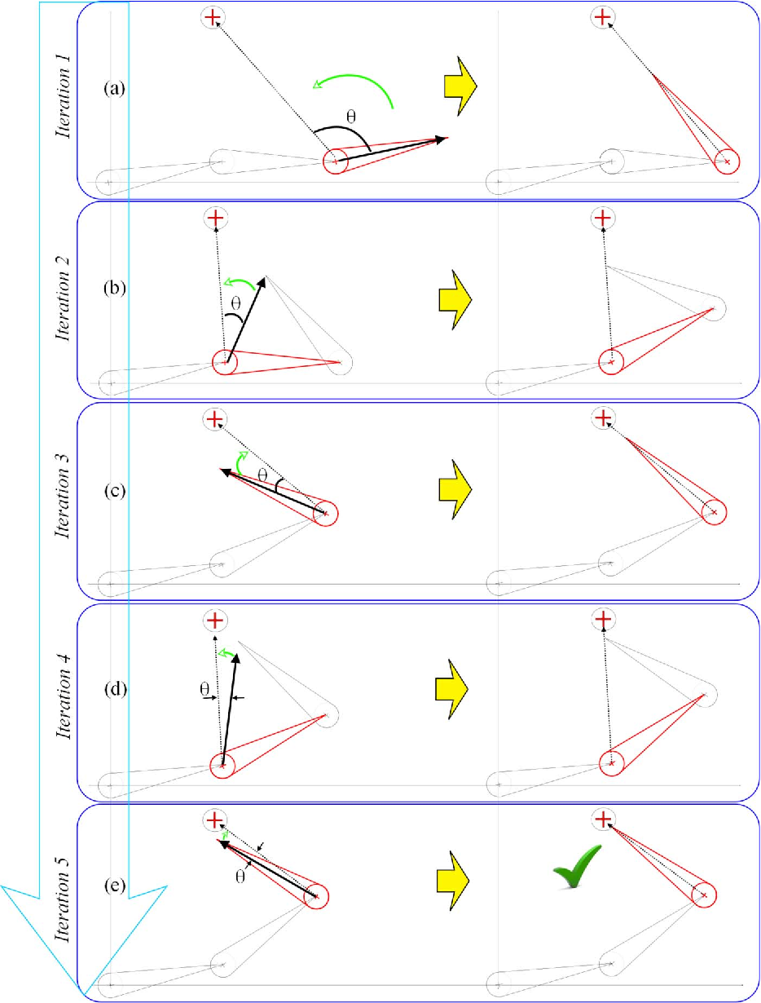
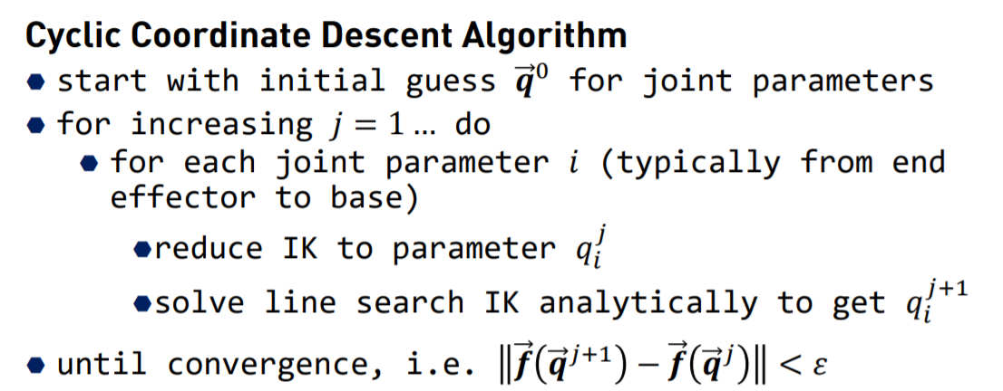
Record users movement with ik
How does IK work? (CCD)
Input: target position
Output: list of dofs along the kinematics chain.
The algorithm is currently imported to my system without modification. I directly used it to compute the pose of the chains.
From slides CG2_SS19_10_IK, Prof. Gumhold
doi: 10.1080/2165347X.2013.823362

Slide 19
Record users movement with ik
How to Support IK algorithm with multiple targets?
Multiple target positions
CCD can not handle multiple end effectors when there are conflicts along kinematic chains.
I chose thorax to be the base bone when controlling with two controllers and hmd. Thus, no conflicts.
If we want to record full body movements, FABRIK algorithm can be used.

Slide 20
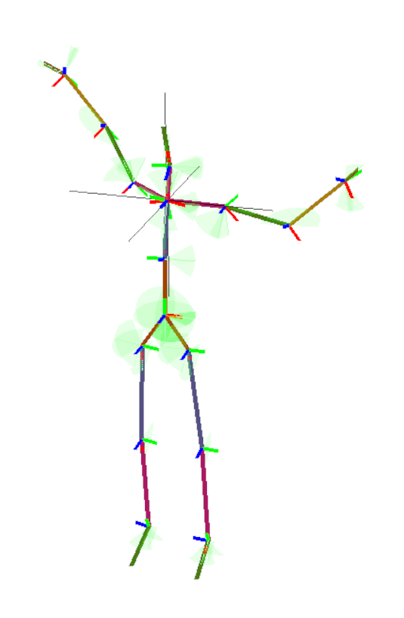
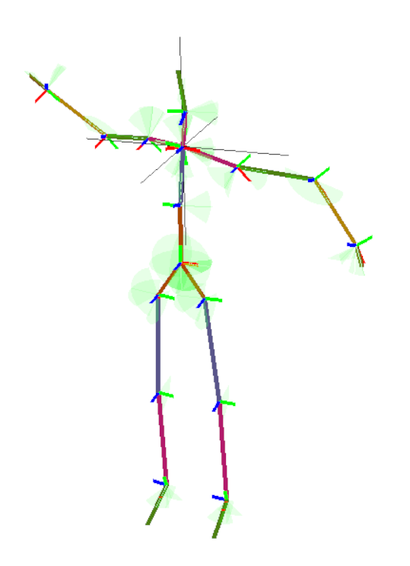
Record users movement with ik
no“conflicts”, the two chains are independent
Target position
Base bone

Slide 21

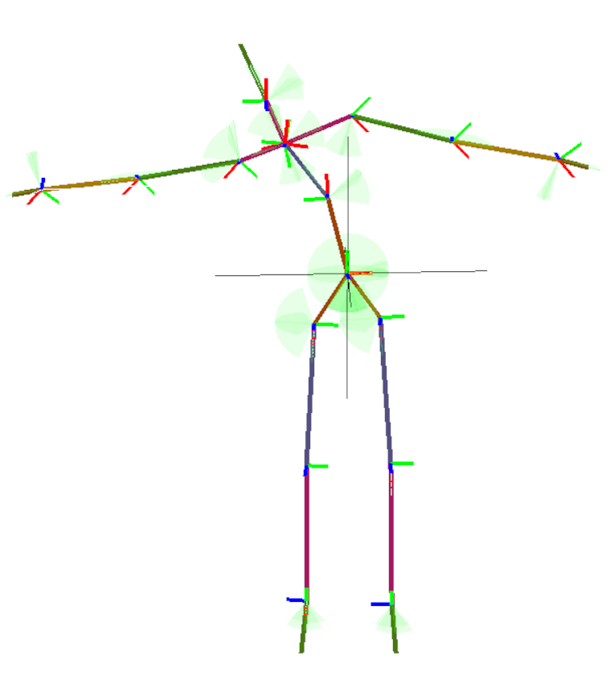
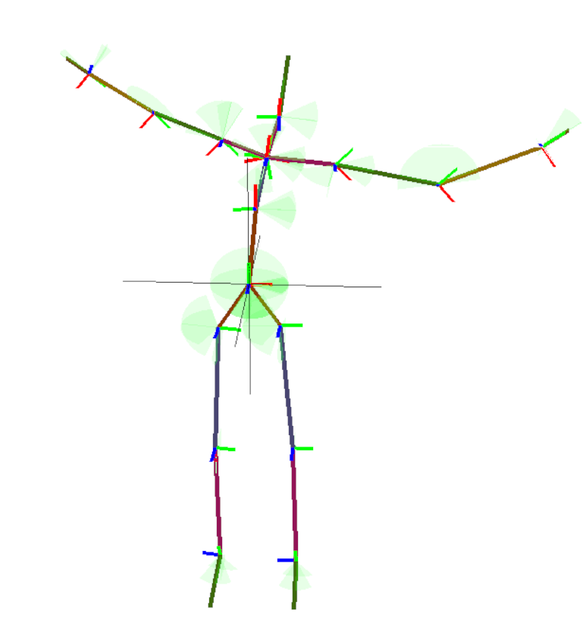
Record users movement with ik
Those two chains have “conflicts”
step1
step2
Target position
Base bone

Slide 22
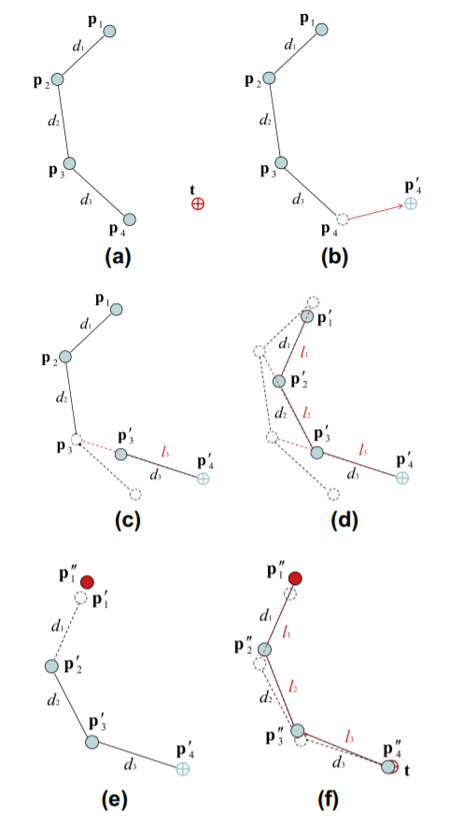
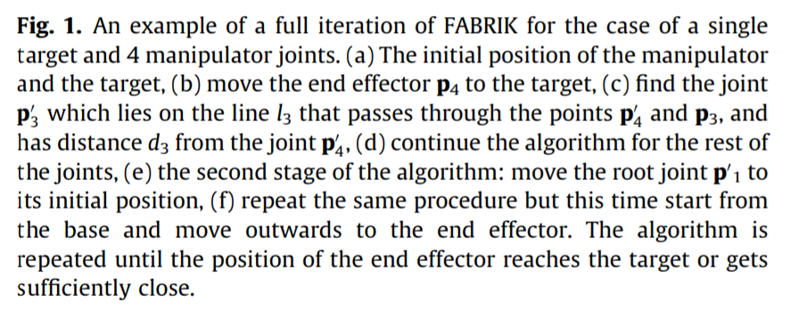
Record users movement with ik
The FABRIK algorithm
CCD is angle based while FABRIK is distance based algorithm.
FABRIK algorithm can work with distinct kinematic chains and has a higher performance.
https://doi.org/10.1016/j.gmod.2011.05.003

Slide 23
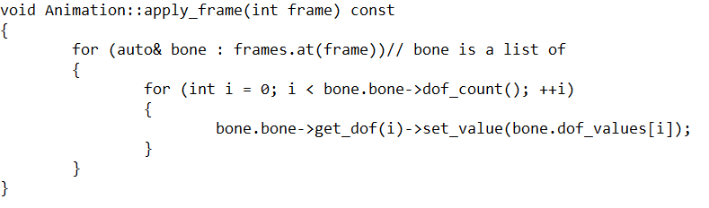
Recording, saving animations
6) Recording, Saving Animations
Implementation Detail:
Animation can be recorded frame by frame. Each frame contains a list of bone dofs.
Load animations by applying bone dofs.
Feature:
Adjestable framerate. Which is 60Hz now. The Output is a file with .anim extension.

Slide 24
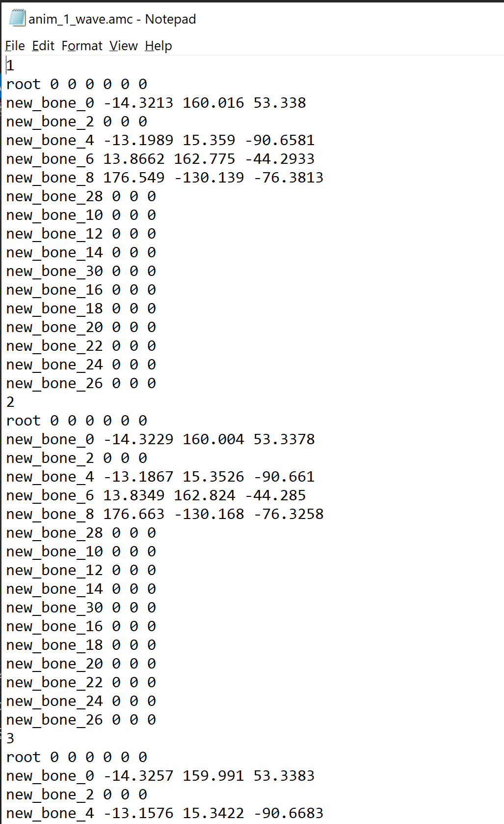
Recording, saving animations
Task 6: Recording, Saving Animations
Implementation Detail:
Animation can be recorded frame by frame. Each frame contains a list of all bone dofs.

Slide 25
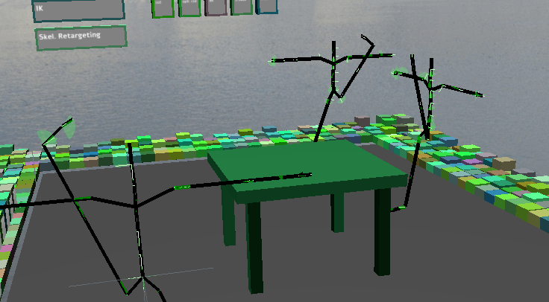
Creating multiple views
Task 7: Creating Multiple Views
Assign bone dofs iteratively.
The other two skeletons imitate the main skeleton.
Multiple skeletons

Slide 26
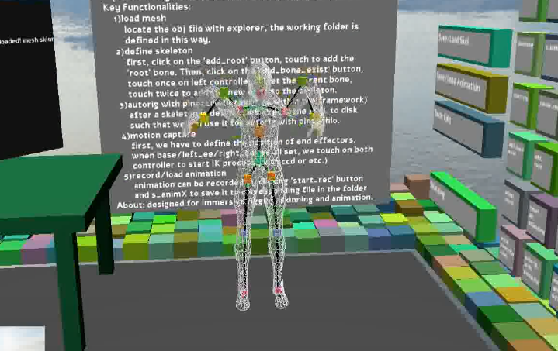
Evaluation of the stability of the mocap (Future work)
Task 8: Evaluation
Orientation information is not used. Only positions are fed to IK, where the orientation of end effectors should also be used.
Full body motion capture not available.
This can be cured by adding more trackers and taking use of the FABRIK algorithm.
Such a motion capture scheme does not guarantee an accurate result. IK problems may be ill-posed. (no solution in range or many solutions exist). Not enough information is provided.
IK based Mocap

Slide 27
Future work
Integrate more IK algorithms to the system and compare them.
Capture Full body motion with more trackers and better algo.
Easier rigging methods. (eg. Just rig half of the mesh, auto-complete)
Load bone weights directly, instead of loading them from an external file.
Generate bone weights with a custom skinning method.

Slide 28


summary

Slide 29
summary
Rigging, Skinning, Animation and Motion Capturing are ported to vr as a whole system.
Mocap/
Rigging
Skinning
Animation
Refine

Slide 30
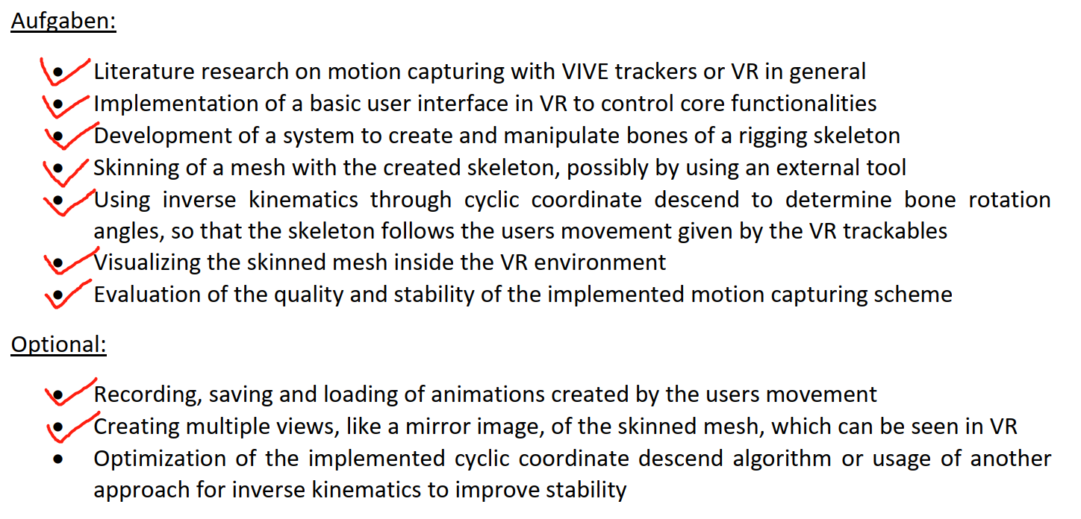
tasks

Slide 31
THANKS FOR YOUR LISTENING !!

